Slide 1
Data Assignment
Bidyut Mondal
Mathematics and Computing
IIT Kharagpur

Slide 2
Analysis
The datasheet contains 10,000 rows and 9 columns
It contains lab report of patients
The different parameter for measurement were : WBC(White Blood Cells), T4(Thyroxine), Sodium, Chloride, SGPT(Serum Glutamic-Pyruvic Transaminase)
The different age groups present were child, teen, adult, old

Slide 3
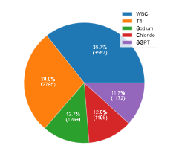
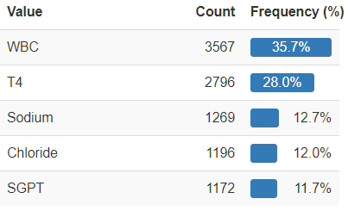
Parameters:

Slide 4
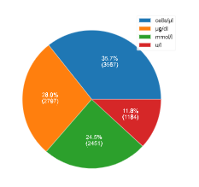
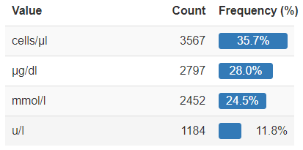
Units(After Pre-processing):

Slide 5
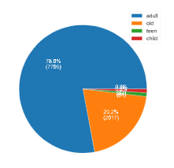
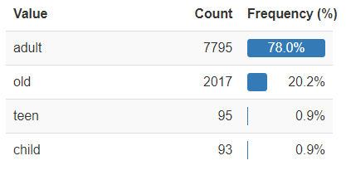
Age Groups:

Slide 6
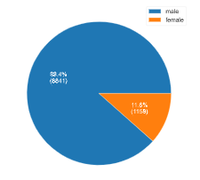
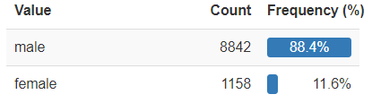
Gender:

Slide 7
Gender Classifier
Steps to building the classifier
Pre-processing the training and test data
Training the train data with different algorithms to check for the optimum one
Training the train data with the best suitable algo(Random Forest Classifier for this case)
Testing the test data with the model
Appending the predicted gender column to the test data

Slide 8
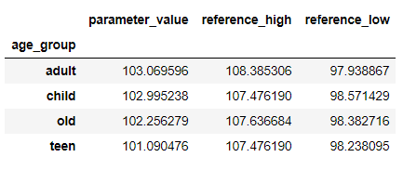
Chloride comparison
Mean of different column (mmol/l)

Slide 9
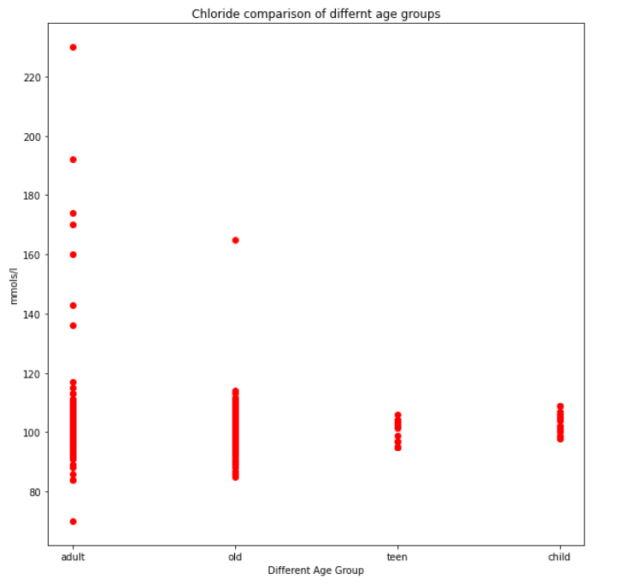
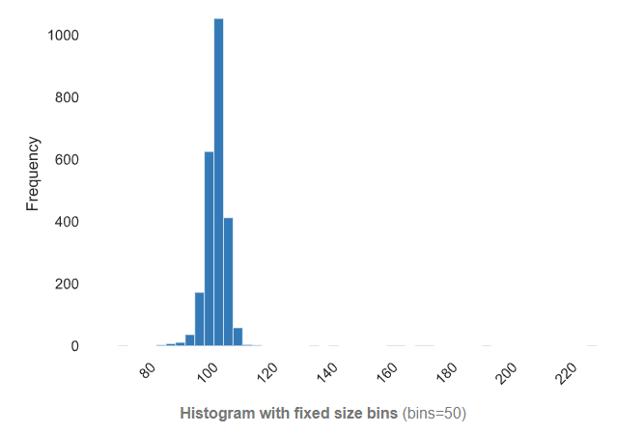

Slide 10
Interesting facts
WBC(White Blood Cells) are a major component of the body’s immune system. A high white blood cell count can indicate the presence of infection, while a low count can point towards various conditions, including HIV/AIDS and lupus
T4(Thyroxine) is produced by thyroid gland. In general, high T4 results may indicate an overactive thyroid gland and low T4 results may indicate an underactive thyroid gland

Slide 11
Sodium and Chloride are electrolytes that help control the amount of fluids and the balance of acids and bases in your body. High levels of chloride may indicate Dehydration, Kidney disease, etc. Low levels of chloride may indicate heart disease, lung disease. Deviation from normal level of Sodium may indicate diarrhea, kidney disorder, diabetes, malnutrition, etc.
SGPT(Serum Glutamic-Pyruvic Transaminase) also called ALT is one of the enzymes that help the liver convert food into energy. Deviation from normal level may indicate hepatitis, cirrhosis, death of liver tissue, a lack of blood flow to the liver

Slide 12
Practical applications
Lab tests can catch the warning signs of almost any disease early
Many heart, lung, and kidney conditions can be diagnosed using blood tests
Based on the parameters of lab test, a classifier can predict if someone has any disease or deficiency of any components
With proper input a model can very accurately predict the condition of any patient

Slide 13
THANK YOU

